Slide 1
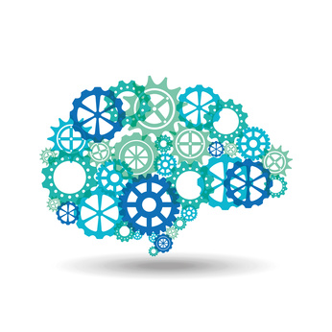

From Machine Learning to GenAI
Dr. Shailesh Sivan

Slide 2
Overview
Confused?
What is machine learning?
Programming vs Learning
Machine Learning Pipeline
When to use Machine Learning?
ML Application
Types of Learning

Slide 3
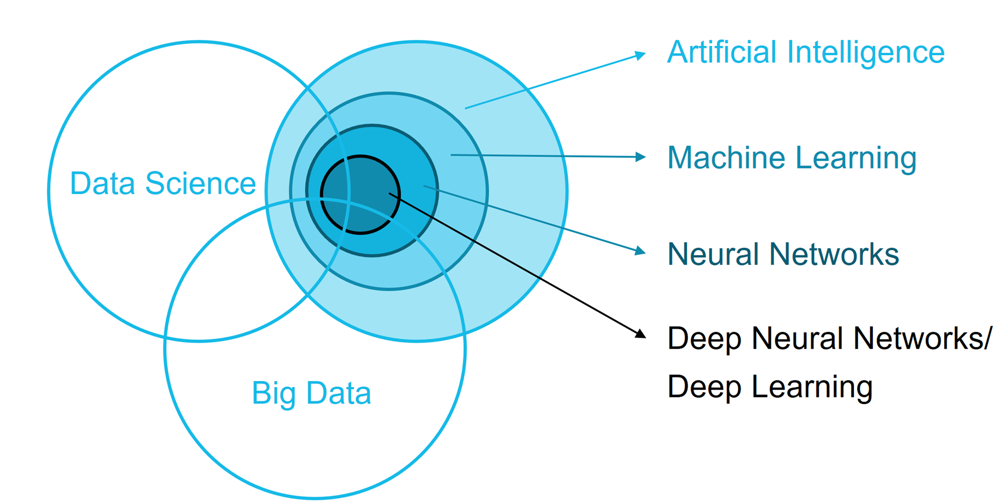
Confused ?

Slide 4
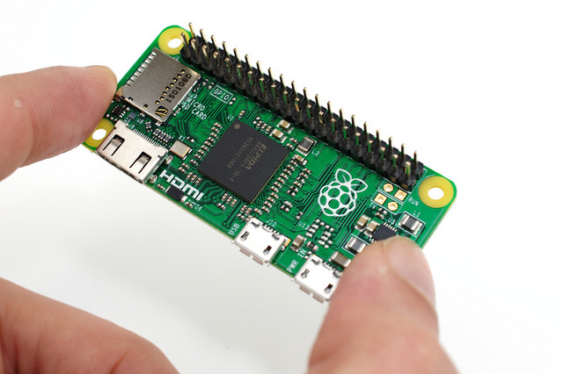
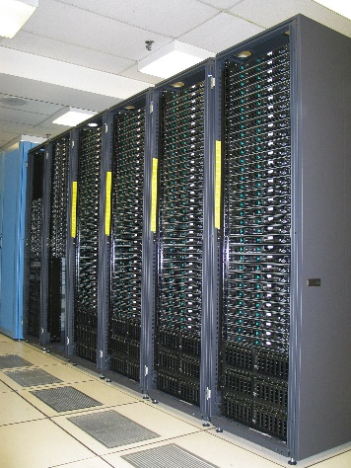
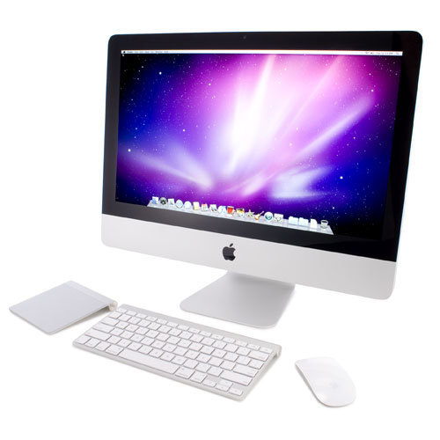
Computer Systems
One which do computing
An electronics device
Capable of storing and processing data
Can be used for controlling other devices

Slide 5
Robots and Computer
Are Computers Intelligent or Dumb ?
COMPUTERS ARE DUMB ☹ !
Computer is not a magical device.
It performs only those works which man can does
But with very high speed and reliable accuracy.
It has no any intelligence quality or thinking power

Slide 6
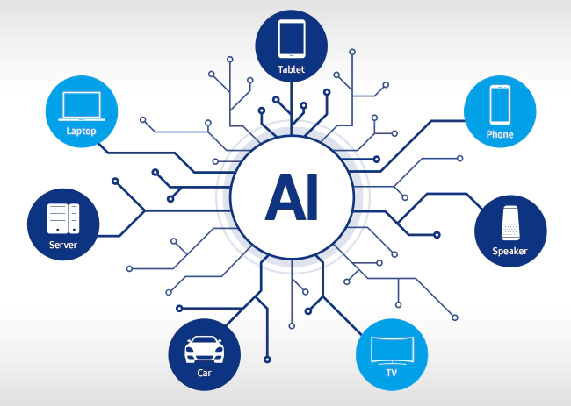
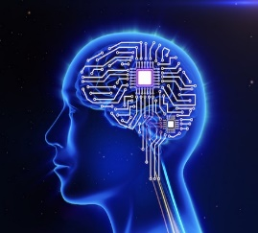
Artificial Intelligence
Can We make Computers Intelligent ?
Yeah Of course !
+ Knowledge = Artificial Intelligence
Artificial Intelligence is a scientific domain that’s deals with making intelligence to system
To make a system “think like a human”

Slide 7
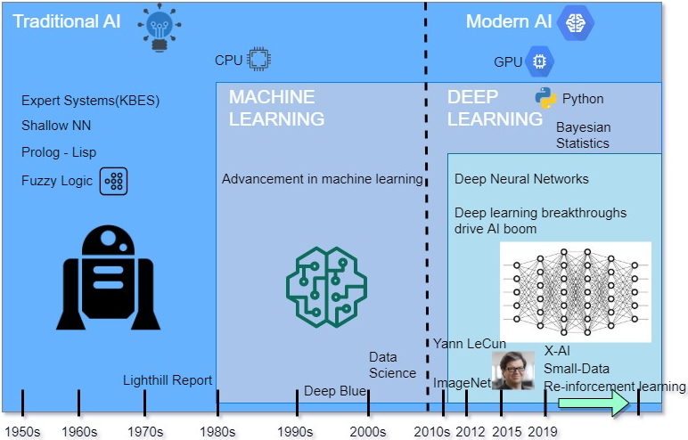
Artificial Intelligence

Slide 8
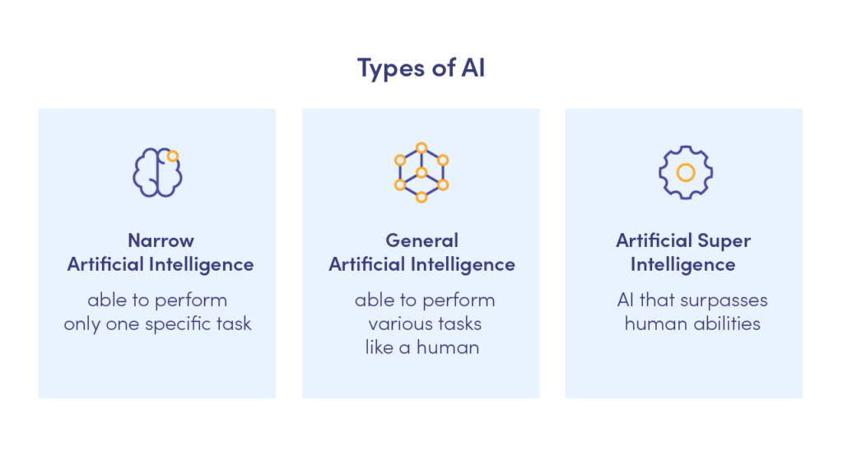
Artificial Intelligence

Slide 9
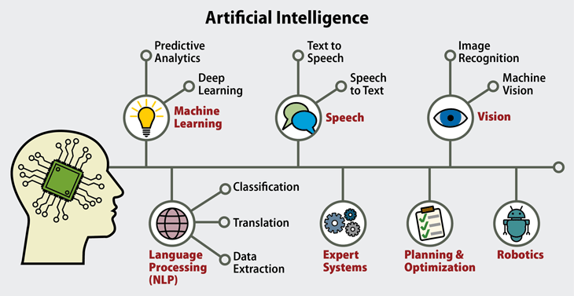

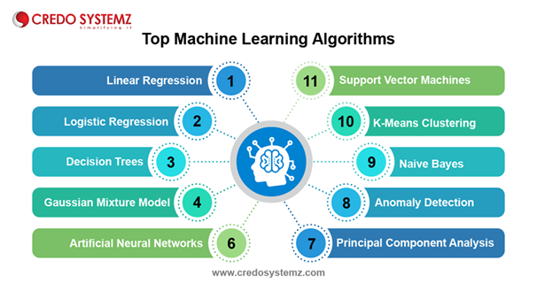

Slide 10
Confused ?

Slide 11
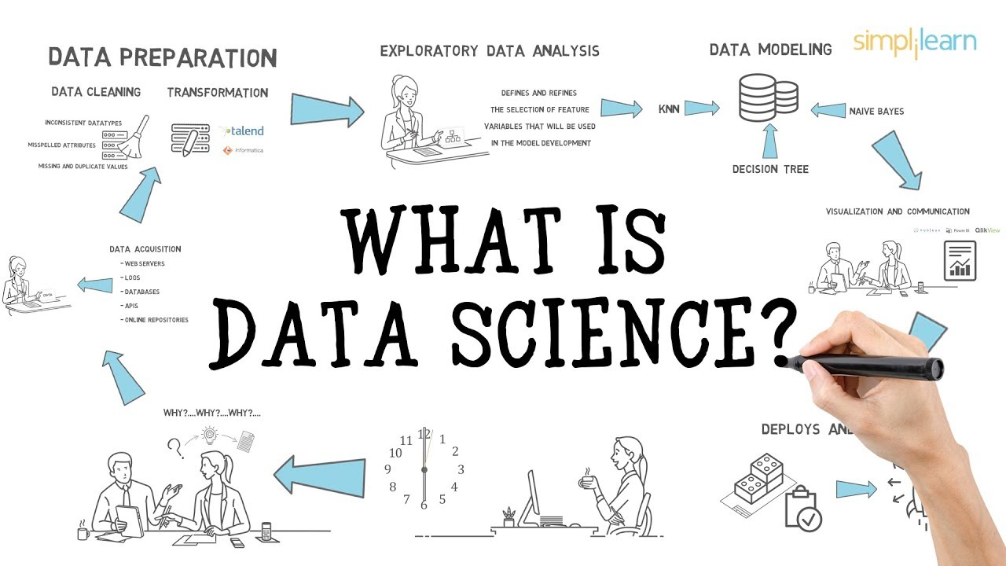
Data Science

Slide 12
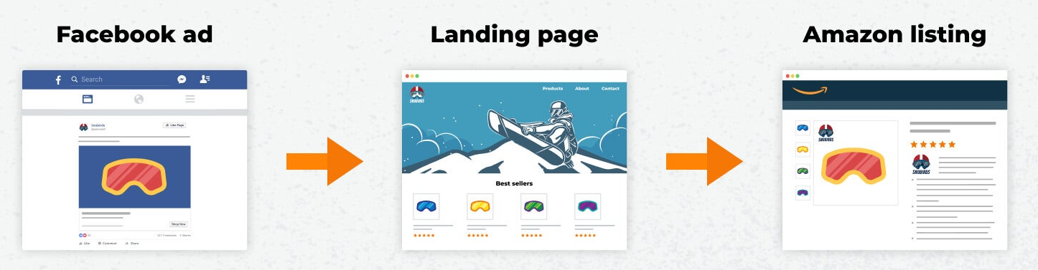
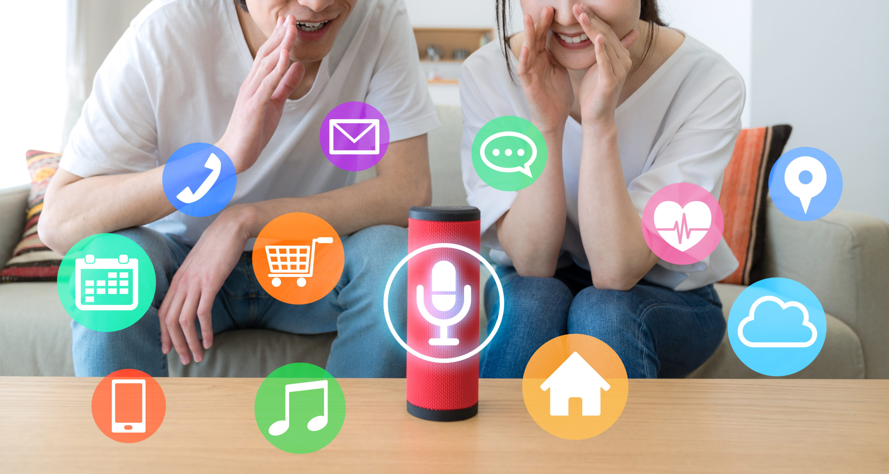
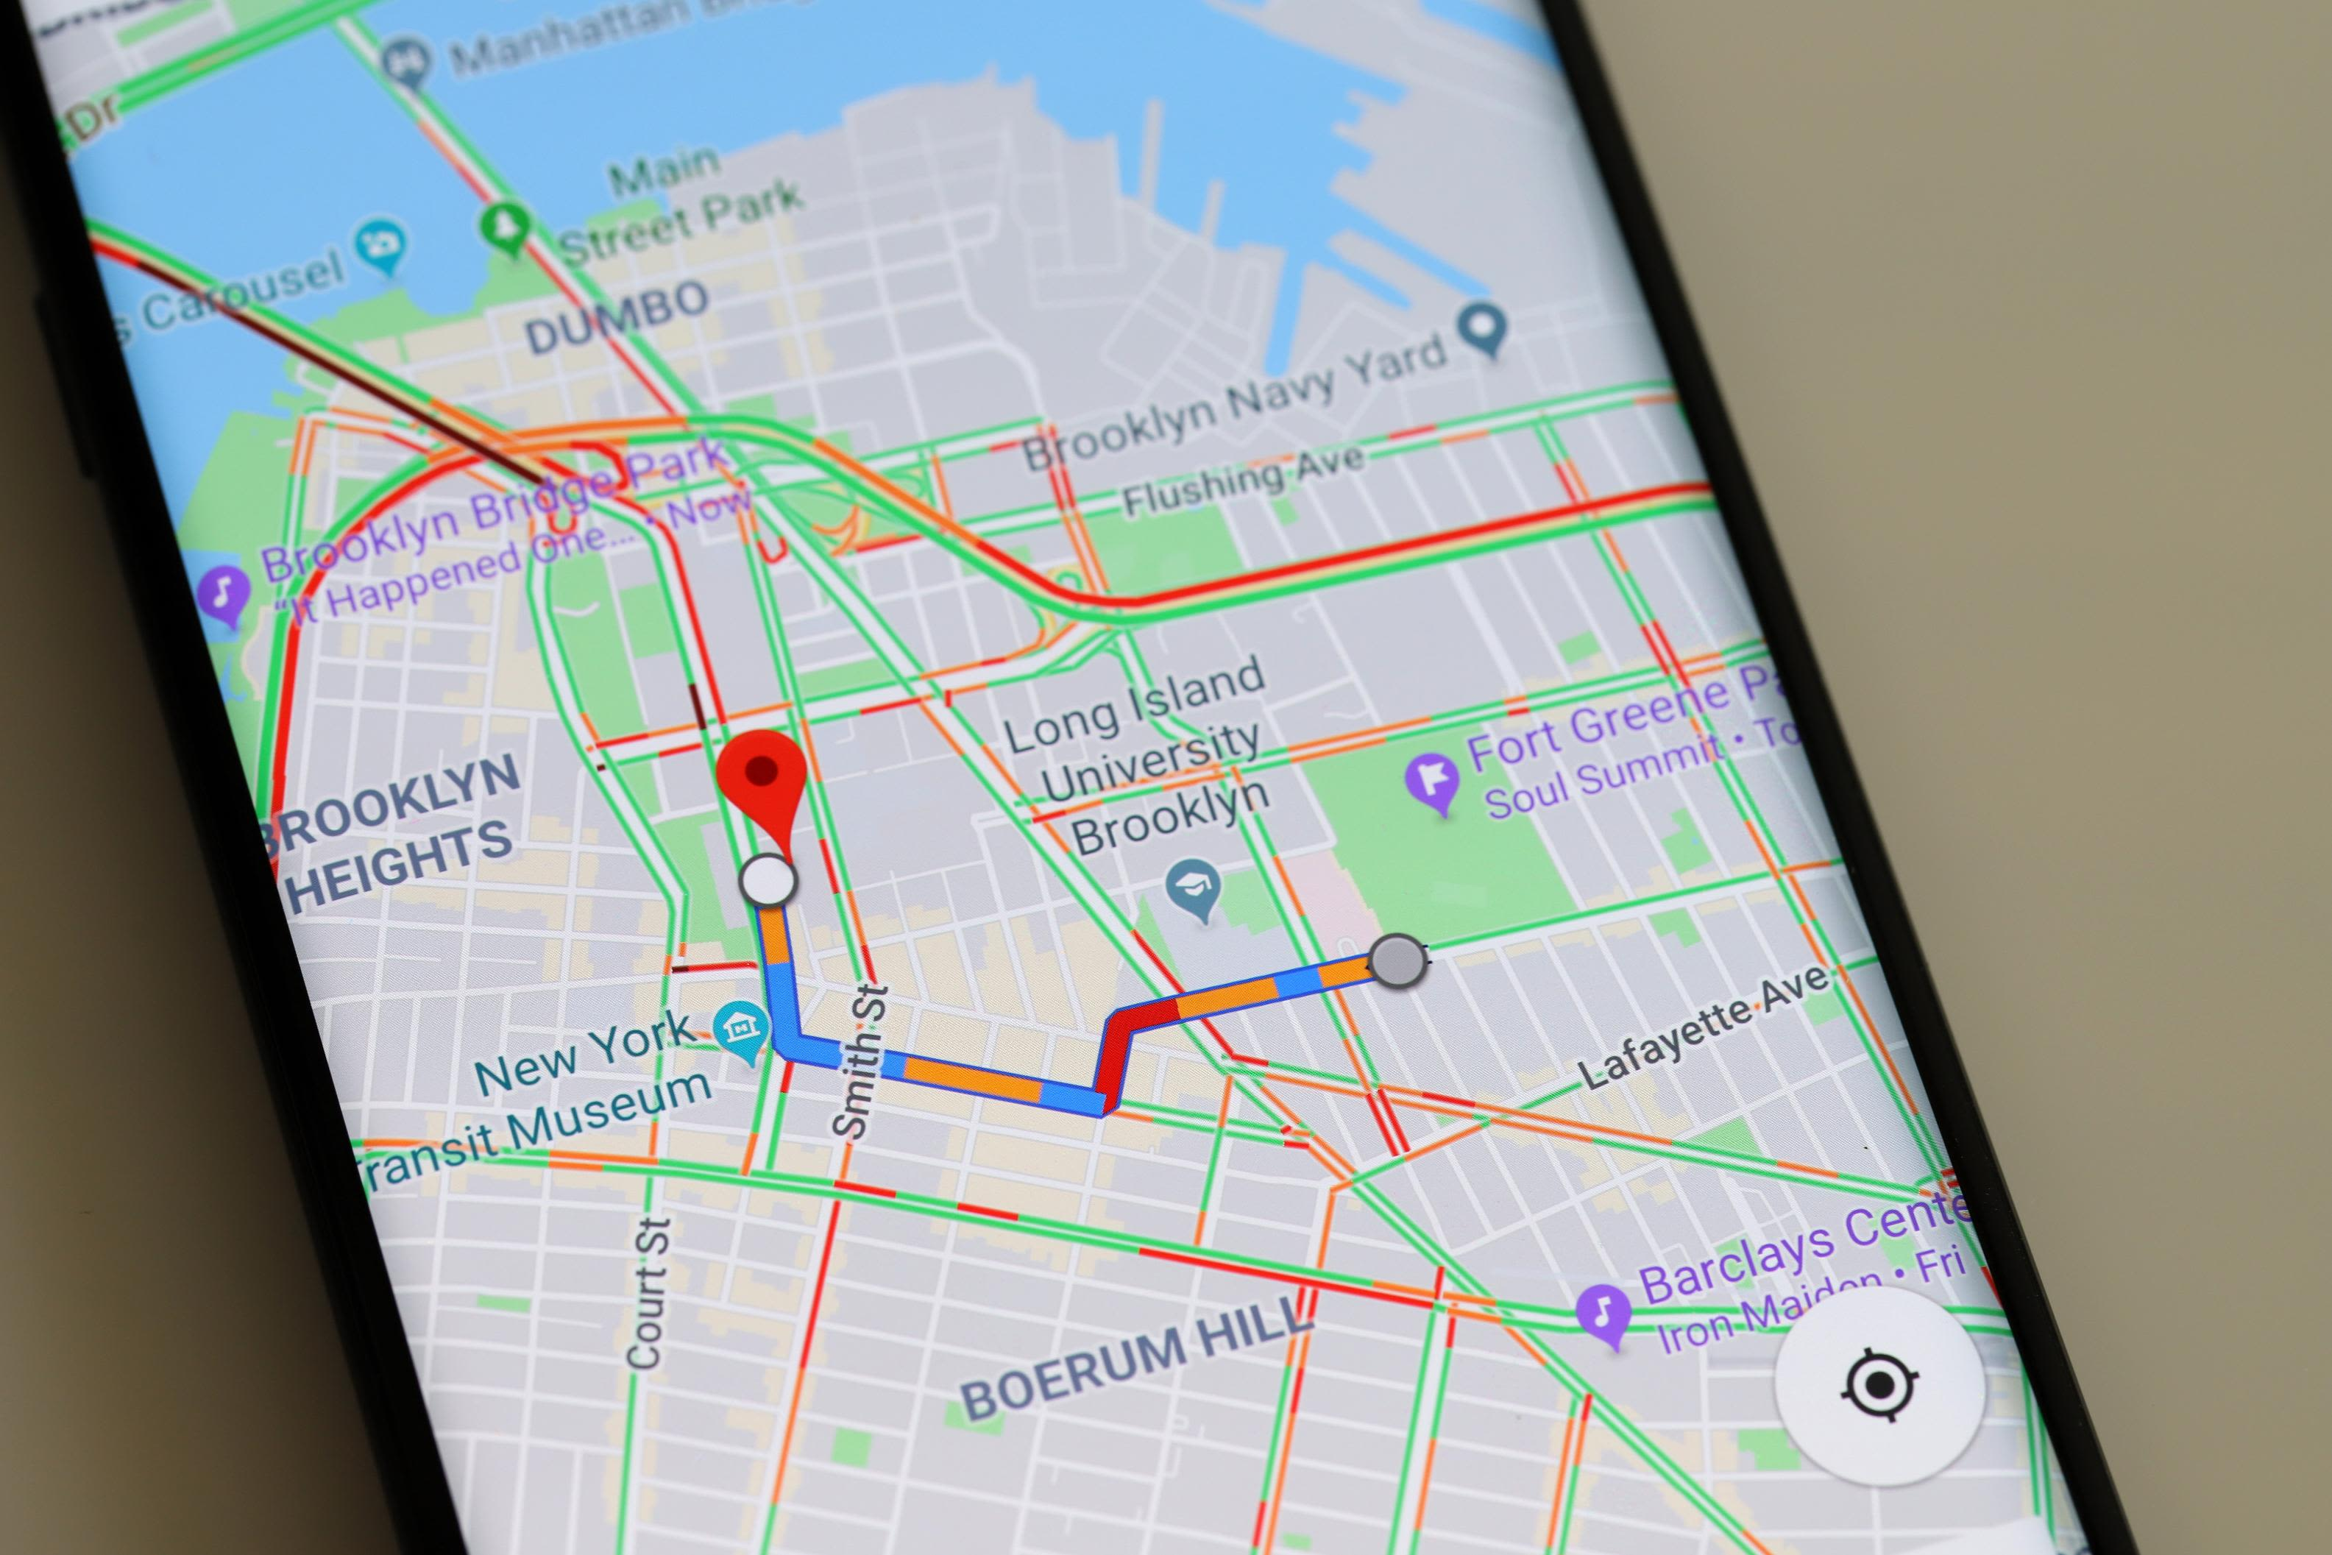
IS Data IMPOTANT?

Slide 13
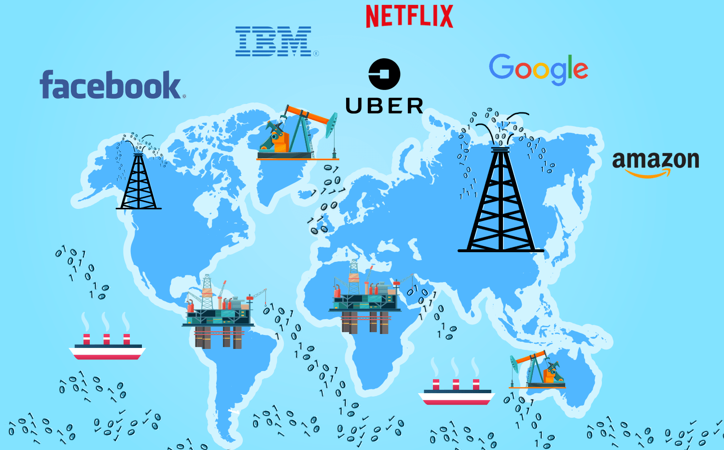
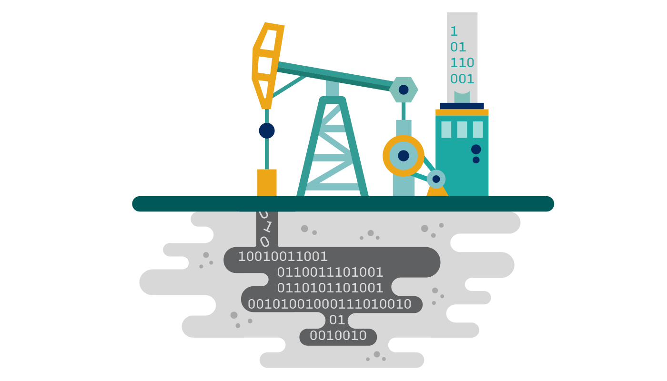
Why Data IS IMPORTANT ?
Make Informed Decisions
Get The Results You Want
Find Solutions To Problems
Back Up Your Arguments
Be Strategic In Your Approaches
Keep Track Of It All
Know What You Are Doing Well
DATA IS NEW OIL

Slide 14
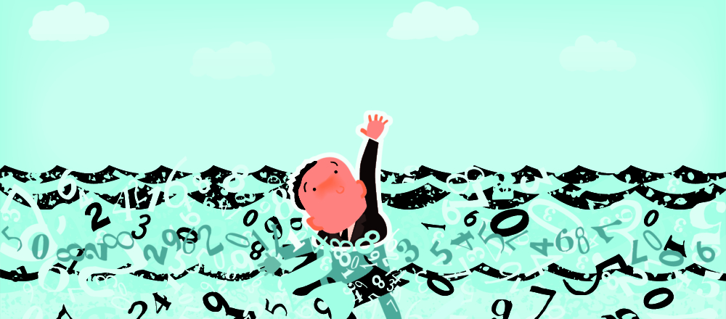
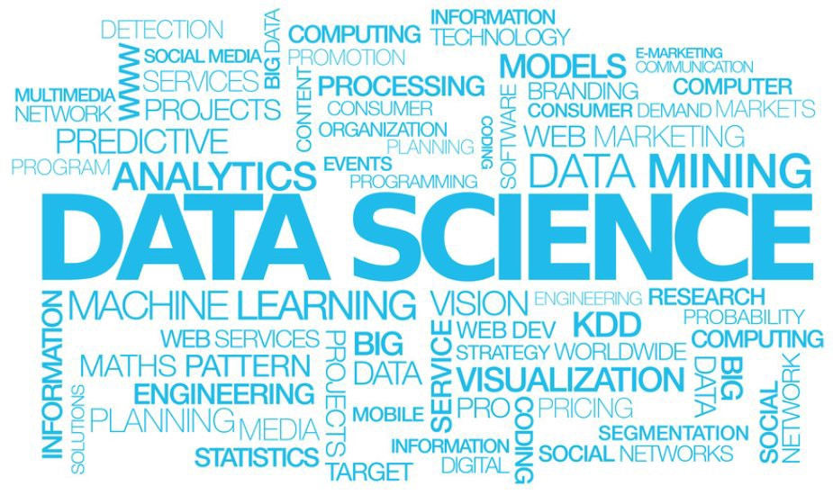
Reality ABOUT DATA
SOLUTION ?
We are now drowing in data ! but starving for insights ☹

Slide 15
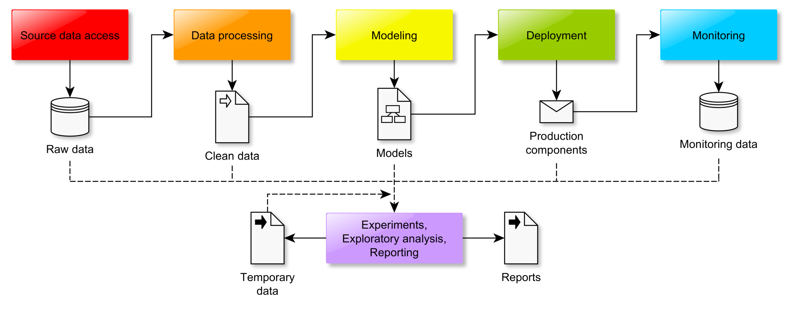
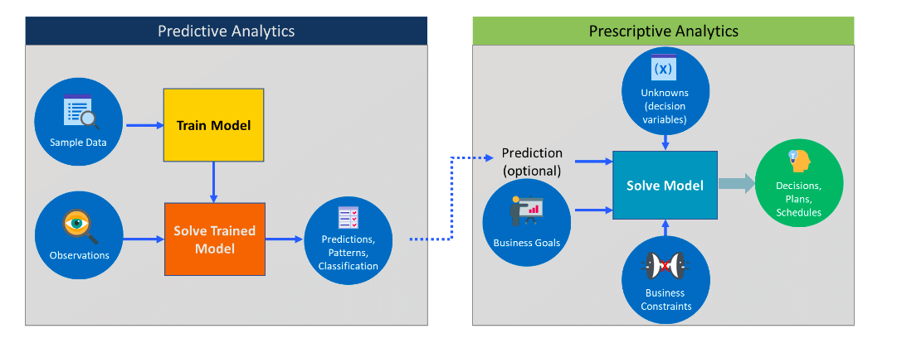
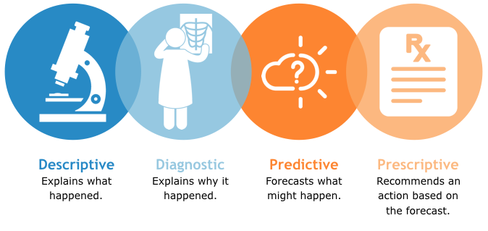
Data Science Pipeline

Slide 16
Confused ?

Slide 17
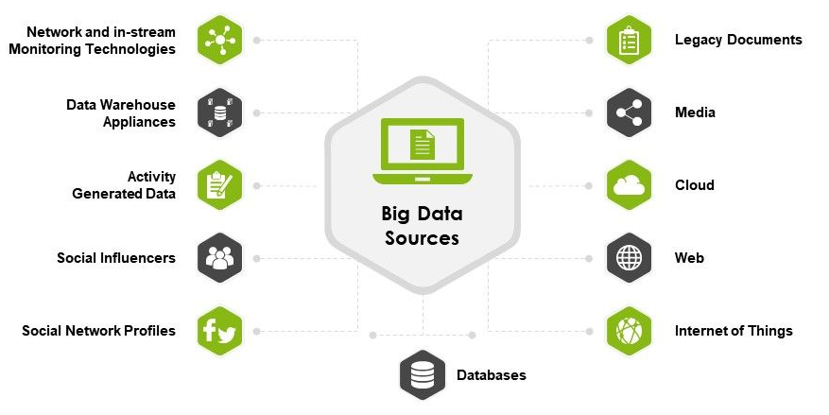
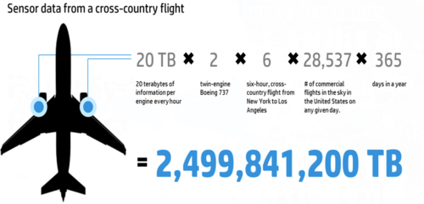
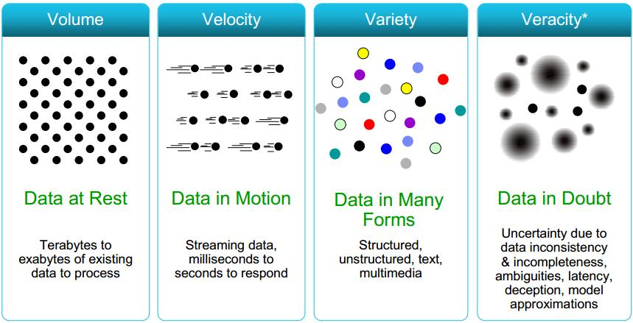
Big Data
Properties of Bigdata
Is Big Data = Large Data ?

Slide 18
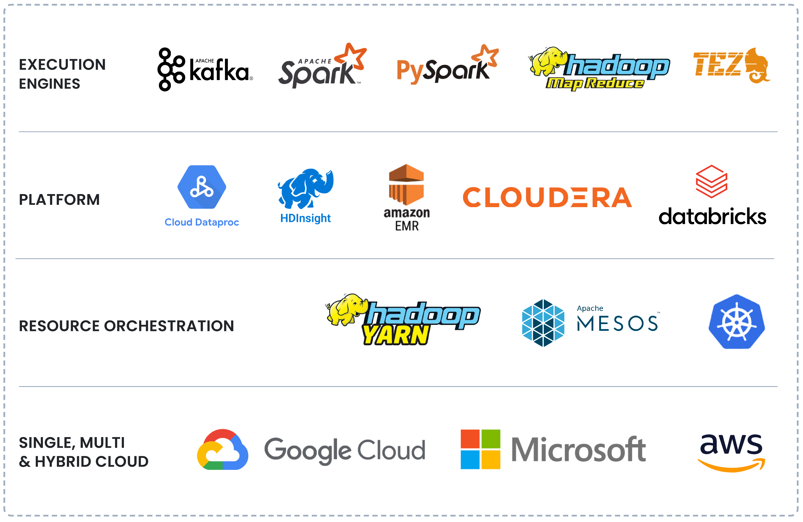
Big Data

Slide 19
What is machine learning?
“Learning is any process by which a system
improves performance from experience.”
- Herbert Simon
Definition by Tom Mitchell (1998):
Machine Learning is the study of algorithms that
- improve their performance P
- at some task T
- with experience E.
A well-defined learning task is given by <P,T,E>

Slide 20
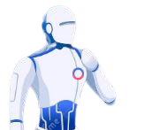

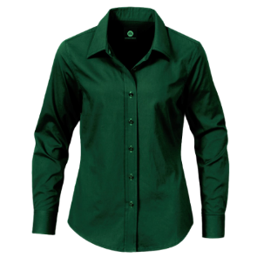
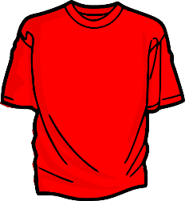
Color: Green
Size : Large
Type : Formal
This is a shirt we used to wear.
Color: Green, red
Size : Large, small
Type : Formal, casual
Color: Green
Size : Large
Type : Formal
Is this a shirt ?
Ok
No!
This is also a shirt

Slide 21

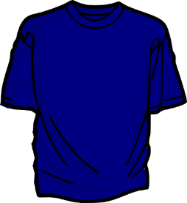


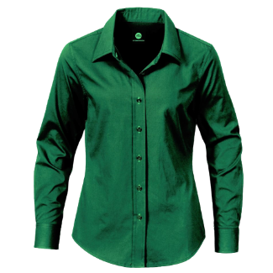

Color: Green, red
Size : Large, small
Type : Formal, casual
Color: Green, red, yellow
Size : Large, small, medium
Type : Formal, casual
Is this a shirt ?
Ok
No!
This is also a shirt
Now I can identify every shirt
Yes, these are all shirts

Slide 22
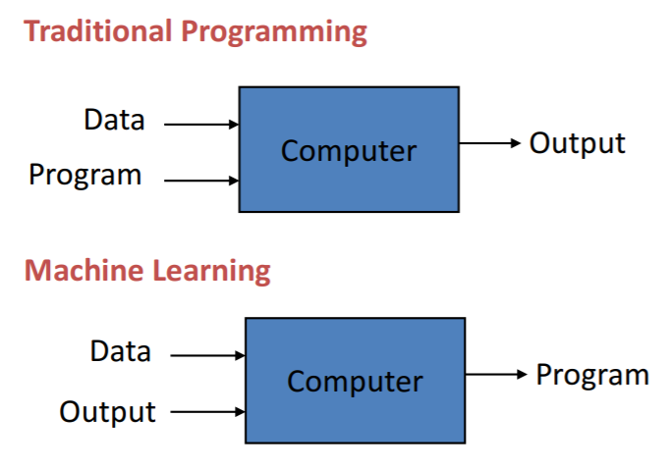
Programming vs Learning

Slide 23
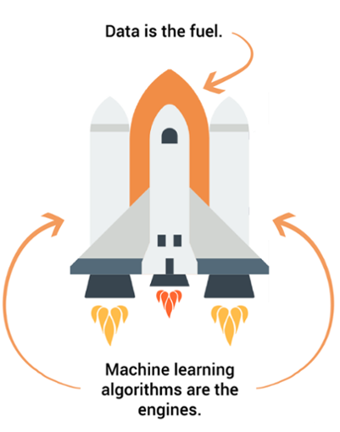
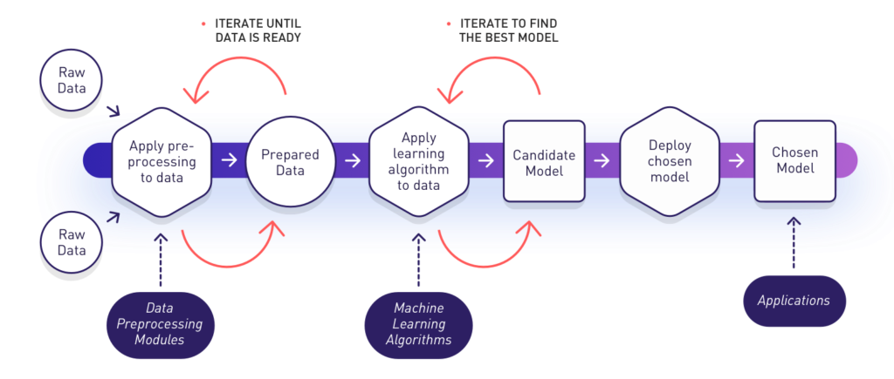
Machine Learning Pipeline

Slide 24
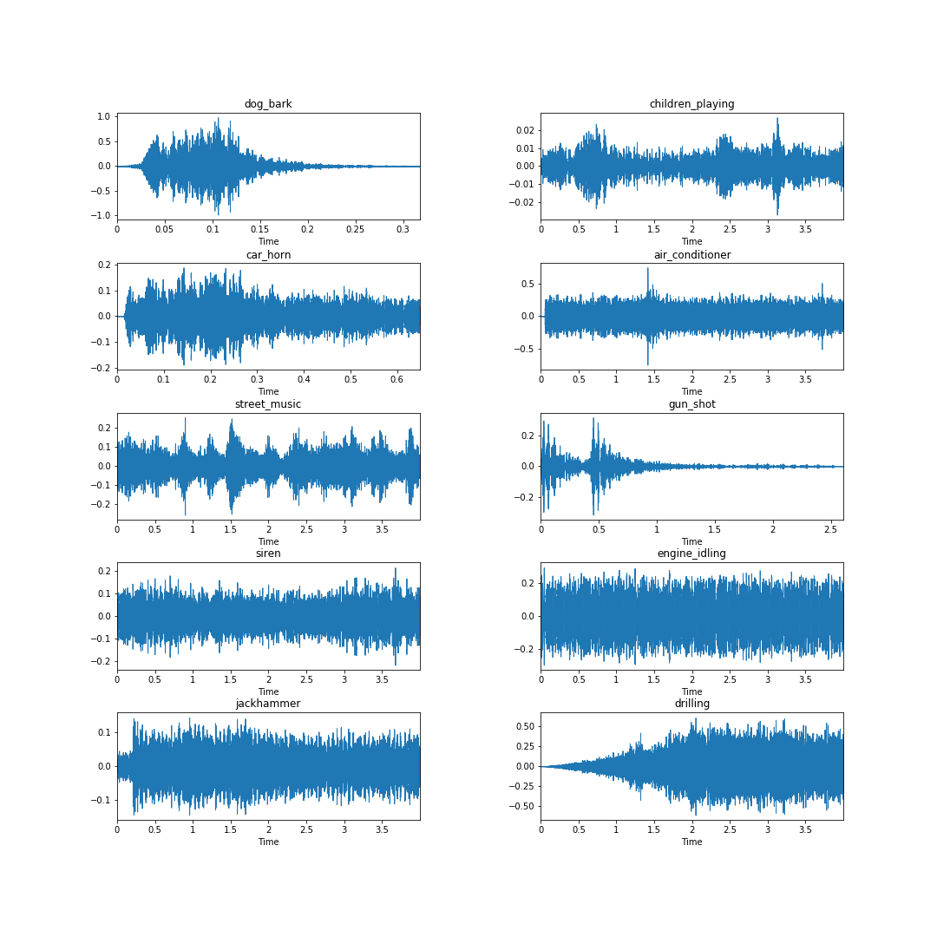
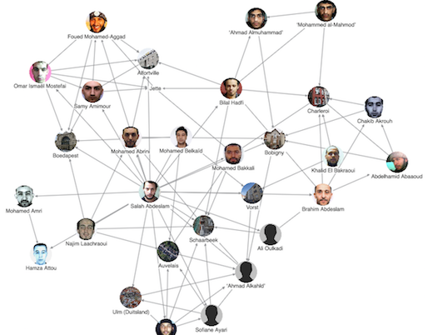
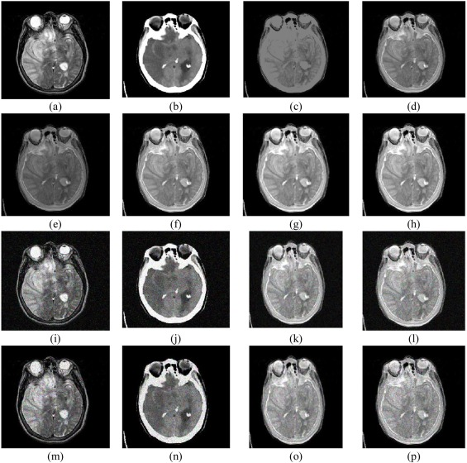
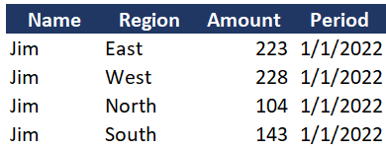
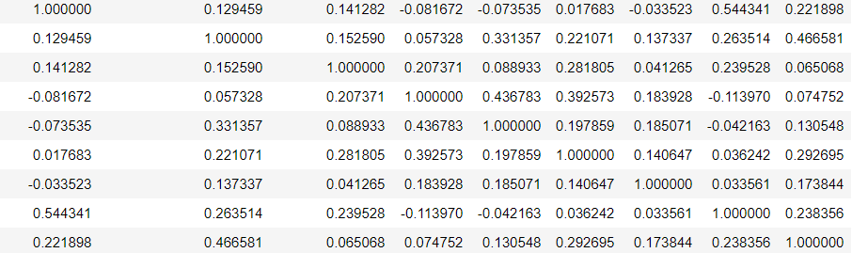
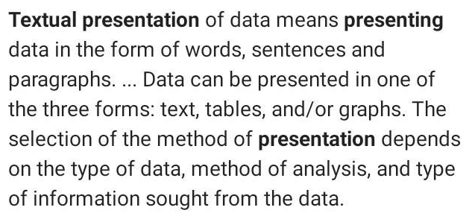
DATA as FEATURE VECTORS
Raw Data
Feature Engineering
Feature Vector

Slide 25
When to machine learning?
ML is used when:
Human expertise does not exist (navigating on Mars)
Humans can’t explain their expertise (speech recognition)
Models must be customized (personalized medicine)
Models are based on huge amounts of data (genomics)
Learning isn’t always useful - There is no need to “learn” to calculate payroll

Slide 26

Types of Learning

Slide 27
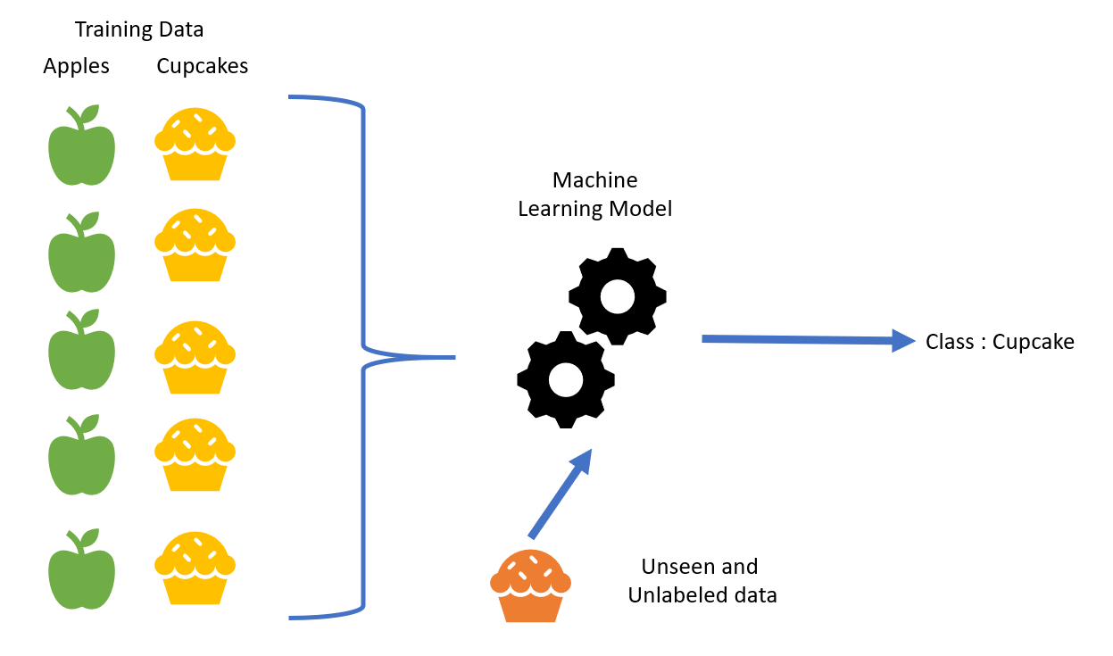

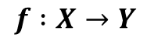
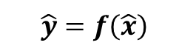
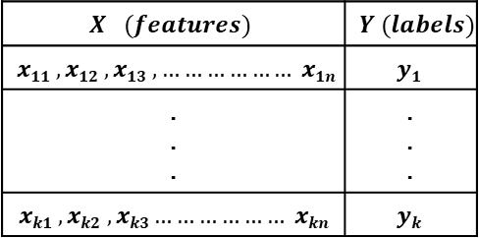
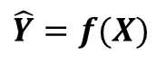
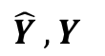
Supervised Learning
$$X (features)$$ | $$Y (labels)$$
$$x11 , x12 , x13 , ……………… x1n$$ | $$y1$$
. . . | . . .
$$xk1 , xk2 , xk3……………… xkn$$ | $$yk$$
Input : Labeled Data
Goal : Construct a predictor
to minimize the error between
where,
$$f :X→Y$$
$$\hat{Y} , Y$$
$$\hat{Y}=f(X)$$
Use : using predictor to predict
$$\hat{y}=f\left(\hat{x}\right)$$
For the unknown input
$$\hat{x}$$

Slide 28
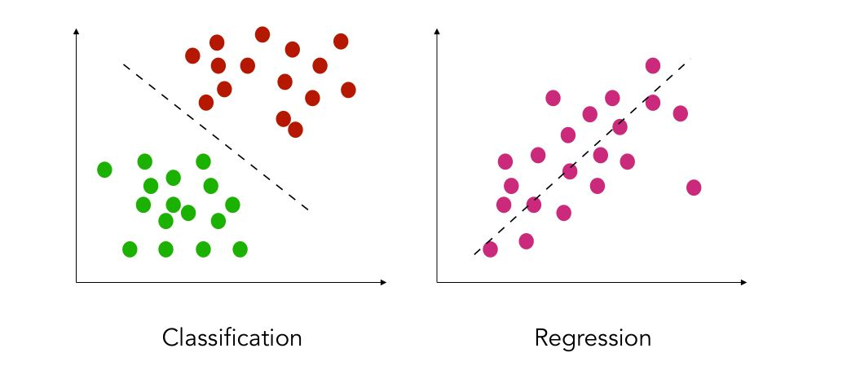

Supervised Learning
Classification
features and discrete labels
maps an input to discrete label(class)
Eg: spam or not, type of cancer
Regression
features and continues real values
Predict a real value for an input
Eg: gold price, temperature

Slide 29
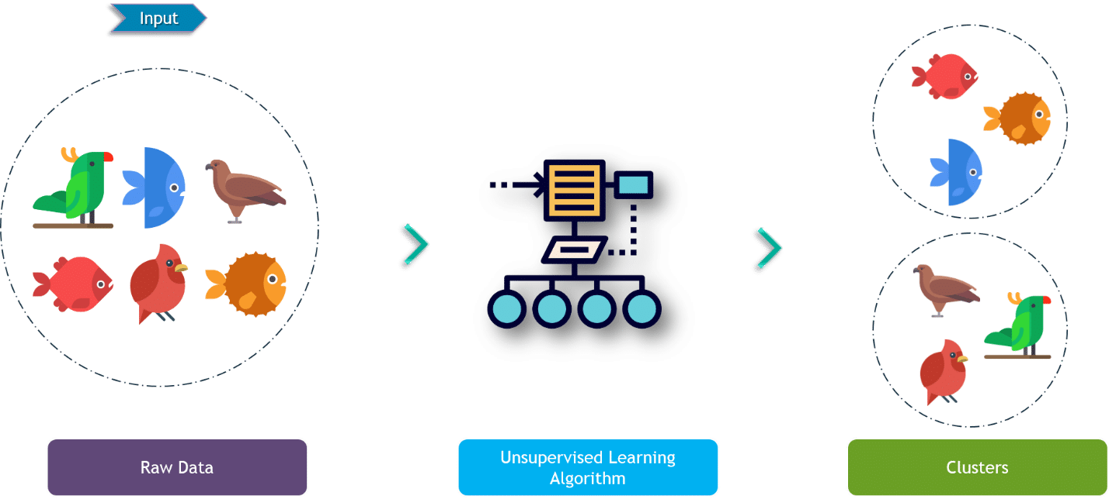
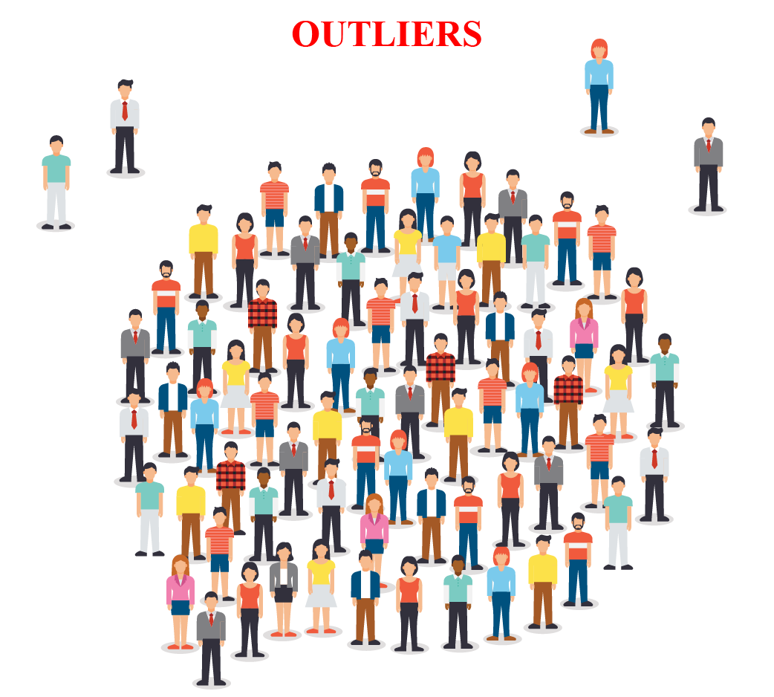
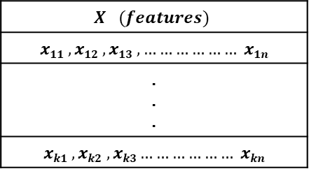

Unsupervised Learning
$$X (features)$$
$$x11 , x12 , x13 , ……………… x1n$$
. . .
$$xk1 , xk2 , xk3……………… xkn$$
Input : Unlabeled Data
Goal : Construct a analyzer to find the hidden relationship between inputs
$$x1, x2,x3,…,xk$$
Use : Group or associate inputs according to their similarity

Slide 30




Unsupervised Learning
Clustering
Itemset and rule mining

Slide 31

Reinforcement Learning
Use software agents
Based on rewards
Objective is to maximize rewards for better learning

Slide 32

Semi Supervised Learning
In a nutshell, semi-supervised learning (SSL) is a machine learning technique that uses a small portion of labeled data and lots of unlabeled data to train a predictive model

Slide 33

Artificial Neural network

Slide 34

DEEP LEARNING

Slide 35

DEEP LEARNING(VISION)
Convolutional Neural Networks

Slide 36


DEEP LEARNING(NLP)
Reccurent Neural Networks

Slide 37


Generative AI/MODELS

Slide 38

GeneRATIVE vs DISCRIMINATIVE MODELS

Slide 39


GeneRATIVE vs DISCRIMINATIVE MODELS
Discriminative Model
Generative Model

Slide 40


GeneRATIVE vs DISCRIMINATIVE MODELS

Slide 41
HOW GENERATIVE MODELS WORKS?

Slide 42


ENCODER-DECODER

Slide 43




ENCODER-DECODER(VISION)

Slide 44

ENCODER-DECODER(TEXT)

Slide 45




ENCODER-DECODER(TEXT-VISION)
IMAGE CAPTIONING
VISUAL QUESTION ANSWERING

Slide 46




GENERATIVE ADVESERIAL NETWORKS(GANs)

Slide 47



The SECRET : Transformer

Slide 48

The SECRET : Transformer

Slide 49


Transformer to GPT(AN LLM)
Generative Pretrained Model(GPT)
GPT-3 (Generative Pre-trained Transformer 3) is a language model that was created by OpenAI.
The 175-billion parameter deep learning model is capable of producing human-like text and was trained on large text datasets with hundreds of billions of words.
GPT uses an unmodified Transformer decoder, except that it lacks the encoder attention part.

Slide 50



DIFFUSION

Slide 51


Slide 52
Popular GEN AI PRODUCTS
Model | Organization | Use cases
GPT-4 | OpenAI | Content generation, code generation, creative writing, question answering
ChatGPT | OpenAI | Dialogue generation, chatbot development
DALL-E 2 | OpenAI | Product design, concept art, image editing
Whisper | OpenAI | Transcription, translation, accessibility
Megatron-Turing NLG | Meta | Content generation, code generation, creative writing, question answering
Jurassic-1 Jumbo | Meta | Factual language modeling, topic summarization, question answering, translation
Flan-T5 | Meta | Code generation
Bard | Google AI | Content generation, code generation, creative writing, question answering
PaLM | Google AI | Factual language modeling, topic summarization, question answering, translation
Meena | Google AI | Dialogue generation, chatbot development
Turing NLG | Microsoft | Content generation, code generation, creative writing, question answering
CodeGPT | Microsoft | Code generation
DialoGPT | Microsoft | Dialogue generation, chatbot development
Copilot | GitHub | Code generation suggestions
Midjourney | Midjourney | Art and design, product design, education
LLaMA | Meta | Content generation, code generation, creative writing, question answering

Slide 53

IMPACT OF GEN AI
Create new content
Music
Images
Videos
Text
Provide creatives with more flexibility and imagination
New ideas and perspectives
Faster prototyping and iteration
Explore new possibilities
Improve machine learning algorithms
Generate new training data
Improve the performance of machine learning models
Significant impact
Enable the creation of new and useful content
Improve the performance of machine learning systems

Slide 54
Why Gen AI Exist ?
Gen-AI can create new content. One of the key benefits of Gen-AI is its ability to generate new content, such as text, images, or music. This can be used to create new art, music, and other forms of creative expression, and to generate data for training machine learning models.
Gen-AI can improve efficiency and productivity. By automating the generation of content, Gen-AI can help save time and reduce the need for manual labor. This can improve efficiency and productivity in a variety of fields, from journalism and content creation to data annotation and analysis.
Gen-AI can improve the quality of generated content. With advances in machine learning and natural language processing, Gen-AI is becoming increasingly sophisticated and capable of generating high-quality content that is difficult for humans to distinguish from real content.
Gen-AI can enable new applications and uses. The ability of Gen-AI to create new content opens up many possibilities for new applications and uses. For example, it can be used to create personalized experiences, such as personalized news articles or personalized music recommendations.

Slide 55
GEN AI and SOCIETY?
Healthcare: Gen-AI is being used to develop new drugs and treatments, to improve the accuracy of medical diagnosis, and to personalize healthcare treatments.
Education: Gen-AI is being used to create personalized learning experiences, to develop new educational tools and resources, and to make education more accessible and affordable.
Business: Gen-AI is being used to automate tasks and improve productivity, to develop new products and services, and to make better business decisions.
Transportation: Gen-AI is being used to develop self-driving cars and trucks, to improve traffic flow, and to make transportation more efficient and accessible.
Manufacturing: Gen-AI is being used to automate production processes, to improve the quality of products, and to make manufacturing more efficient and cost-effective.
Entertainment: Gen-AI is being used to create new video games, movies, and music, and to make entertainment more personalized and engaging.

Slide 56
Take Aways
Under Standing of AI and Subdomains
Discriminative vs Generative Models
Encoder – Decoder Models
Generative Adverserial Networks(GANs)
Diffusion Networks
LLMs and GPTs
Popular Gen AI Models
Imapct of Gen AI
Gen AI and Society

Slide 57





Dr. Shailesh Sivan
+91 8907230664
shaileshsivan@cusat.ac.in
https://shaileshsivan.info

Slide 58


